Slide 1
Picolinic Acid
Chemistry Training:
A Label Requirement for
Applicators of Invora™ Herbicide

Slide 2
Picolinic Acid Chemistry Training
Topics:
Introduction to Picolinic Acid Chemistry
Invora™ Herbicide
  Introduction
  Use Sites and Application Methods
  Use Restrictions and Precautionary Information
    Manure and Vegetation Management (Composting Awareness)
    Applications Around Desirable Species
    Buffer Zone Requirements
  The Application
Grazing Lands Stewardship
  Grazing management and wildlife considerations
Summary, Testing, & Certification

Slide 3
Introduction to Picolinic Acid Chemistry Training
Picolinic Acid Chemistry Training is required to….
  Increase applicator awareness of some picolinic acid herbicide characteristics
  Educate applicators on appropriate uses of Invora™ herbicide.
  Inform applicators of Invora™ herbicide risks associated with its persistent properties, applications to non-approved sites or to or in the root zones of non-target desirable vegetation, and its off-site movement (e.g. drift)

Slide 4
Introduction to Picolinic Acid Chemistry Training
Commonly asked question:
How is this training applicable to me as a _________?
  Commercial or private applicator
  Distributor or retailer
  Landowner / rancher
The short answer is “to comply with the label requirements”
  This training is to inform and educate applicators and land owners of correct and responsible practices for Invora™ herbicide so risks can be properly managed according to label directions.
  The long answer is “this is a stewardship opportunity for your business and associated industries (chemical, ranching, composting, etc.)”

Slide 5
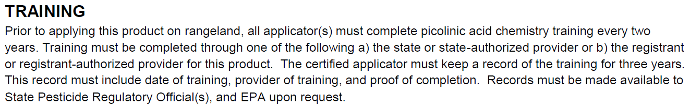
Introduction to Picolinic Acid Chemistry Training
Training Specific for Invora™ Herbicide
This training satisfies the label requirement of all applicators to complete picolinic acid chemistry training every 2 years.
Invora™ herbicide is a Restricted Use Pesticide (RUP) for retail sale to and use only by Certified Applicators and only for those uses covered by the Certified Applicator’s certification.
This training does not qualify for Certified Applicator training required to purchase and use RUPs. See state or federal RUP requirements.
Refer to specific state pesticide regulatory agencies for additional requirements.

Slide 6




Introduction to Picolinic Acid Chemistry
Picolinic Acid Herbicides – a sub-family of Growth Regulator Herbicides
Active Ingredients include:
  Aminocyclopyrachlor
  Triclopyr
  Aminopyralid
  Clopyralid
  Picloram
  Fluroxypyr
  Formulated Products include:
    Invora™ herbicide – Aminocyclopyrachlor + Triclopyr
    Remedy® Ultra – Triclopyr
    Reclaim® – Clopyralid
    Sendero® – Aminopyralid + Clopyralid
    Tordon® 22K – Picloram
    Surmount® – Picloram + Fluroxypyr
    MezaVue™ – Aminopyralid + Picloram + Fluroxypyr
    GrazonNext® HL – Aminopyralid + 2,4-D (Phenoxy)
    Grazon® P+D – Picloram + 2,4-D (Phenoxy)
    Chaparral™ – Aminopyralid + Metsulfuron-methyl (ALS)
    And others including generics products

Slide 7
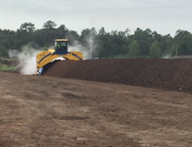
Introduction to Picolinic Acid Chemistry
Most Picolinic Acid Herbicide-Containing Products:
are active on many woody and herbaceous plant species including desirable trees and crops
have relatively long soil residual activity [half (½) lives of weeks to several months]
are highly active even at trace concentrations on non-target plants (many garden plants, crops some trees and shrubs, legumes, etc.)
exhibit continued, residual activity in and/or on vegetation, even after desiccation (e.g. haying)
exhibit persistent activity in livestock manure and urine following ingestion and excretion
No Composting
These properties pose compost contamination concerns

Slide 8
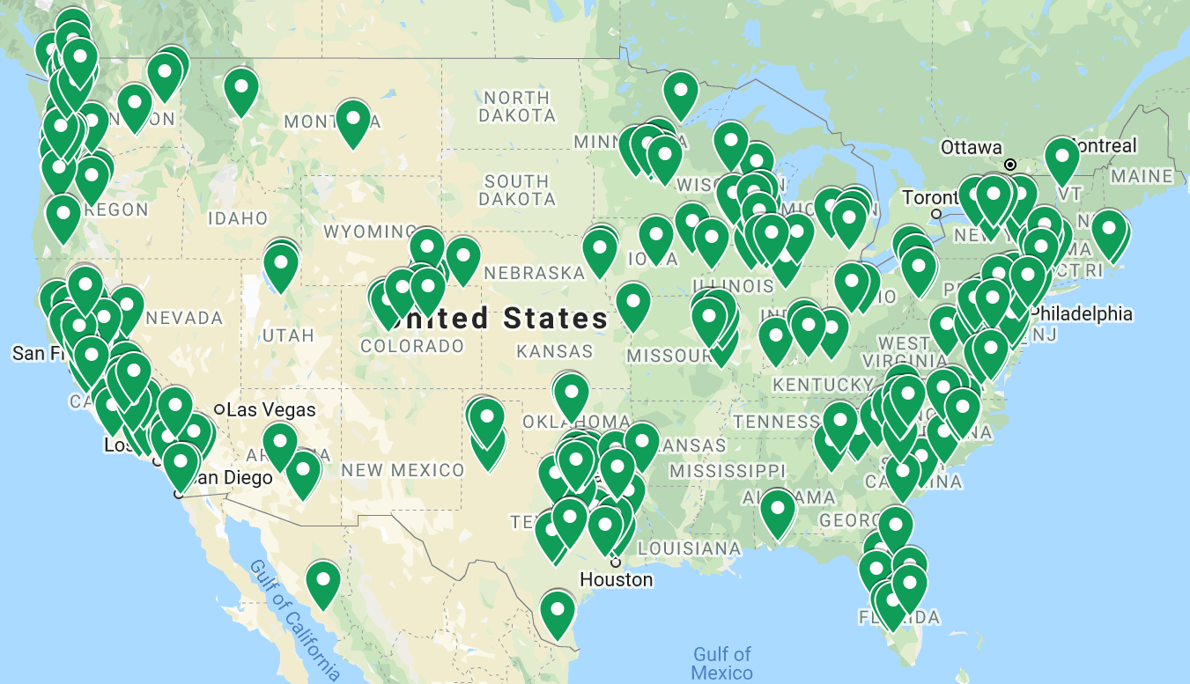
Introduction to Picolinic Acid Chemistry
Composting Awareness – A Growing Industry Near You
Locations of compost facilities registered with US Composting Council
Map does not include non-registered facilities, homeowners, gardeners, nurseries, etc. composters
Select Compost Feed Stocks
Yard trimmings; leaves and grass
Hay and grains
Animal manures
Brush (woody plant material)
https://www.google.com/maps/d/viewer?mid=1KOxGrcoXjvq2za42QvOfqw6UL30&ll=31.142875852552%2C-104.6338659124288&z=6

Slide 9
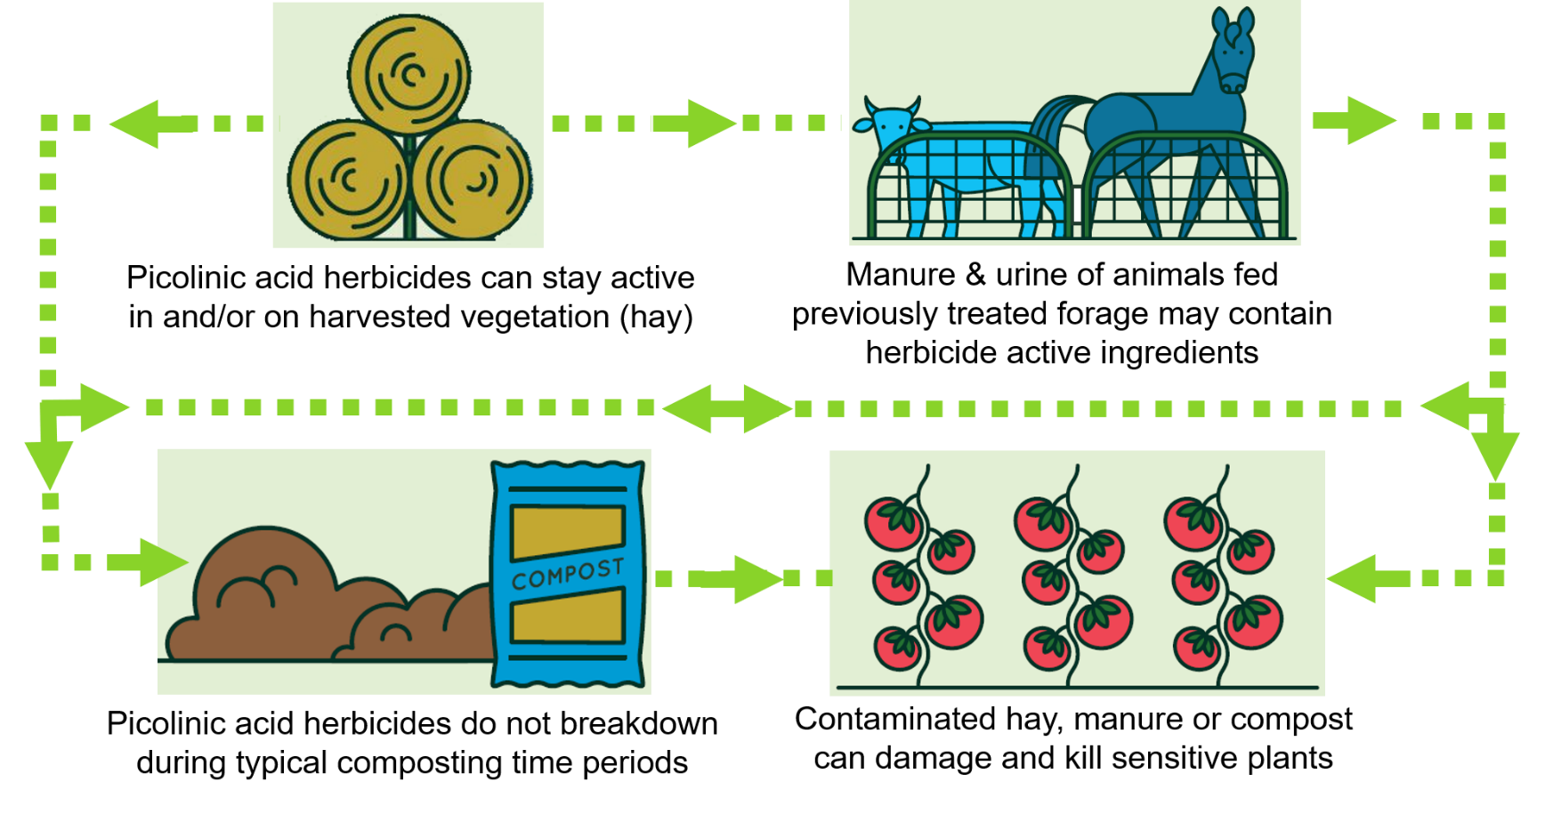
Introduction to Picolinic Acid Chemistry
Composting Awareness – the flow from field to compost
Most picolinic acid herbicide labels restrict composting of:
  vegetation (herbaceous or woody plants, hay, leaves, etc.)
  manure and urine of livestock on treated fields or fed treated hay
Composting restrictions vary. Read and follow directions, restrictions and precautions. Common time restraints:
  an unspecified period of time,
  18 months after application, or
  For Invora™ Herbicide the composting restriction is 2 years
Labels vary. Read and follow all label directions, restrictions, & precautions.
No Composting

Slide 10
Picolinic Acid Chemistry Training
Topics:
✓ Introduction to Picolinic Acid Chemistry
Invora™ Herbicide
  Introduction
  Use Sites and Application Methods
  Use Restrictions and Precautionary Information
    Manure and Vegetation Management (Composting Awareness)
    Applications Around Desirable Species
    Buffer Zone Requirements
  The Application
Grazing Lands Stewardship
  Grazing management and wildlife considerations
Summary, Testing, & Certification

Slide 11
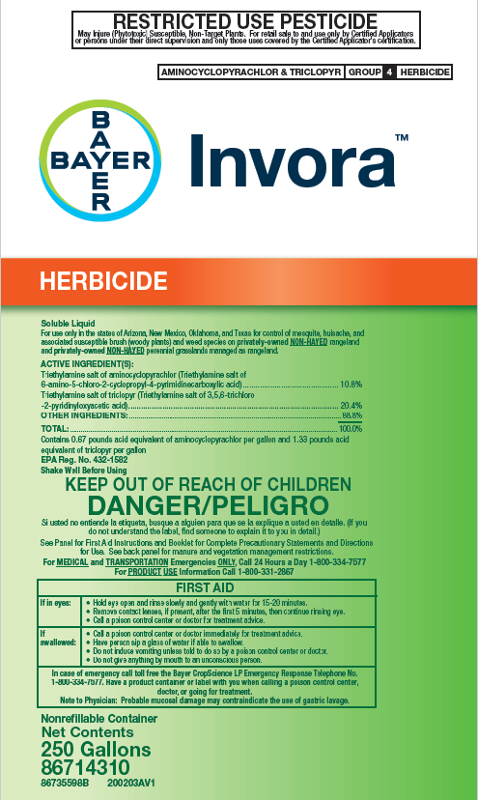
Invora™ Herbicide: Introduction
Premix of two picolinic acid herbicides
  Aminocyclopyrachlor (ACP) - pyrimidine carboxylic acid
  Triclopyr amine - pyridine carboxylic acid
POST-emergence control of many woody species & broadleaf weeds
Residual control of many troublesome broadleaf weeds

Slide 12
Invora™ Herbicide: Introduction
Select Label Restrictions
Invora™ Herbicide Labeling
DO NOT apply to hay production fields
DO NOT apply to public lands
Landowner notification for leased lands
24 month manure and vegetation management restriction for composting
Defined buffer zones: for property lines around water bodies
Applications to or around desirable species
Read and follow all product label directions, restrictions, & precautions.

Slide 13
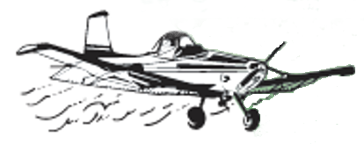


Invora™ Herbicide: Label Requirements
For use on privately-owned, non-hayed, rangeland and perennial grasslands managed as rangelands in the states of Arizona, New Mexico, Oklahoma, and Texas
Applicator Requirements
DO NOT apply this product:
to sites where vegetation will be harvested or manure will be collected within 2 years
broadcast within 100 ft. of property lines, free-flowing water bodies, water bodies shared among property owners, or outer banks of irrigation ditches or canals
directly to or allow to drift into water
in the root zone of or directly to desirable vegetation
if conditions favor movement off site
Read and follow all product label directions, restrictions, & precautions.

Slide 14
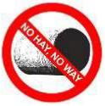


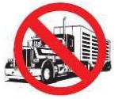
Invora™ Herbicide: Label Requirements
For use on privately-owned, non-hayed, rangeland and perennial grasslands managed as rangelands in the states of Arizona, New Mexico, Oklahoma, and Texas
Land Manager Requirements
For 2 years after treatment:
herbaceous vegetation cannot be harvested, moved off-site, composted, or used as soil amendment or mulch
manure resulting on treatment site cannot be composted, used as soil amendment or mushroom spawn
purge livestock for 3 days before transport
Treated brush must degrade on site
Read and follow all product label directions, restrictions, & precautions.

Slide 15
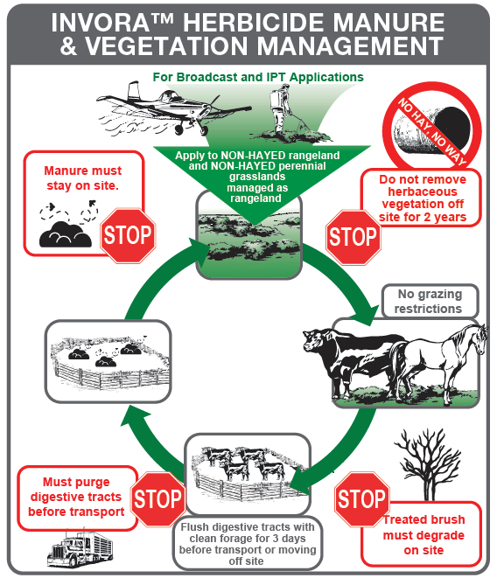
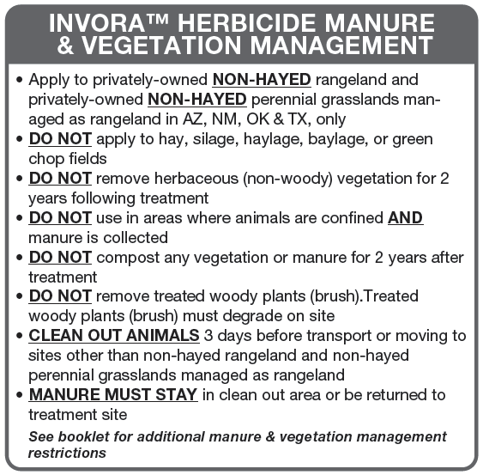
Invora™ Herbicide: Label Diagram
Use Sites and Manure and Vegetation Management (Composting Awareness)
Apply in Place, Leave in Place

Slide 16





Invora™ Herbicide: Use Restrictions & Precautionary Information
Use Sites
NOT for public land use such as:
Private lands under lease agreement:
  Landowner must be notified
  At least 2 years of lease life must remain
  Land mgr. approval/request requirement
  Necessary to observe stewardship
Labeled application methods:
  Aerial or Ground Broadcast
  Individual Plant Treatments (IPT)
    Foliar leaf, Basal stem, & Cut stump
Not for use for Industrial Vegetation Management (IVM) Applications

Slide 17

Invora™ Herbicide: Use Restrictions & Precautionary Information
Use Sites
Not labeled for hay production fields
X
X

Slide 18
Invora™ Herbicide: Use Restrictions & Precautionary Information
Compost Awareness, Grazing Allowance and Slaughter Restriction
To address composting concern:
No Grazing Restrictions
Slaughter Restriction: Within 12 months of an Invora Herbicide application, remove livestock from grazing treated site at least 3 days before slaughter
  A restriction on triclopyr-containing products

Slide 19
Invora™ Herbicide: Use Restrictions & Precautionary Information
Composting Awareness - Treated Brush
To address composting concern:

Slide 20
Invora™ Herbicide: Use Restrictions & Precautionary Information
Composting Awareness - Livestock clean out
Livestock Clean-out Before Transport for 2 years following application
Suggestions: Plan Before Application
Leave portion of rangeland treatment-free
  Move animals to treatment-free rangeland for 3 days prior to moving
  OR
Confine animals on site
  For 3 days feed diet free of treated forage

Slide 21
Invora™ Herbicide: Use Restrictions & Precautionary Information
Composting Awareness - Manure management
When livestock are confined for clean-out:

Slide 22
Invora™ Herbicide: Use Restrictions & Precautionary Information
Potential Compost Contamination Considerations
Follow the “Apply in Place and Leave in Place” concept.

Slide 23
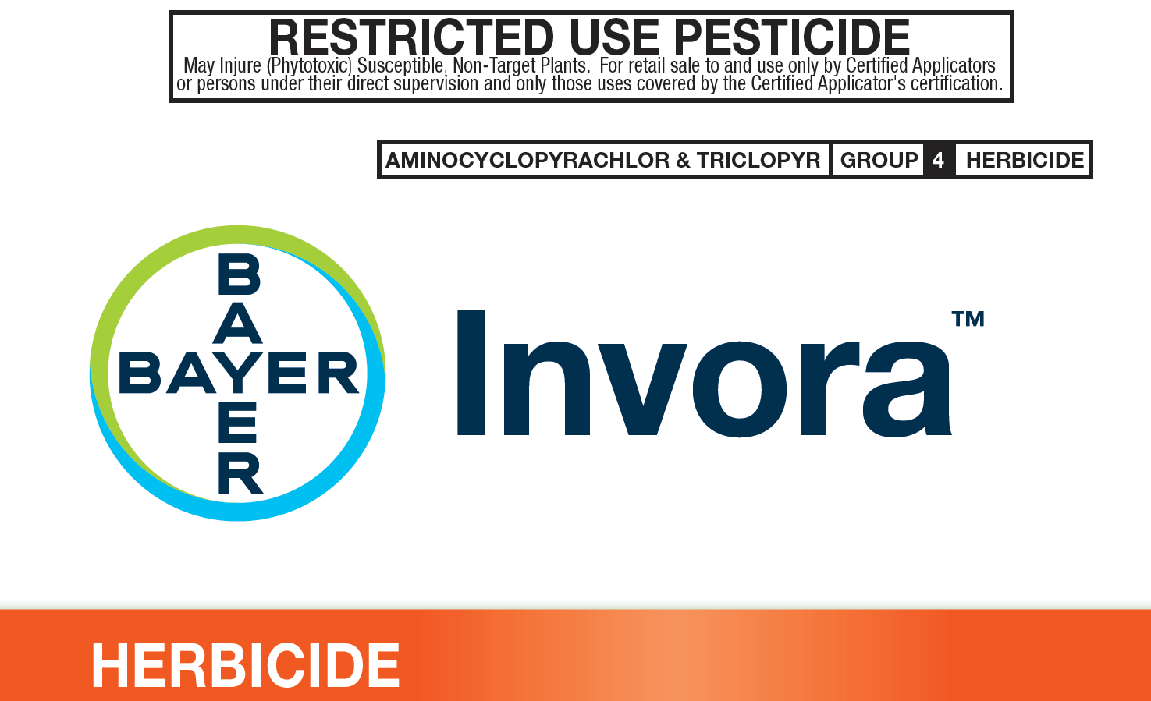
Invora™ Herbicide: Use Restrictions & Precautionary Information
Potential Impact on Non-target, Desirable Vegetation (e.g. trees and crops)
The reason for federal Restricted Use Pesticide classification

Slide 24
Invora™ Herbicide: Use Restrictions & Precautionary Information
Potential Impact on Non-target, Desirable Vegetation (e.g. trees and crops)
Species sensitivity statement from the label:
Certain species may, in particular, be sensitive to low levels of INVORA™ HERBICIDE including but not limited to conifers (such as Douglas fir, Norway spruce, ponderosa pine and white pine), deciduous trees (such as aspen, Chinese tallow, cottonwood, honey locust, magnolia, poplar species, redbud, silver maple, and willow species), and ornamental shrubs (such as arborvitae, burning bush, crape myrtle, forsythia, hydrangea, ice plant, magnolia, purple plum and yew).
Do not drift on, spray, or apply in the root zone of desirable species. Note: tree root zones may extend well beyond their drip lines.
Broadleaf crops or trees and annually planted grass crops (wheat, barley, oats, etc.) are Invora™ Herbicide-sensitive

Slide 25
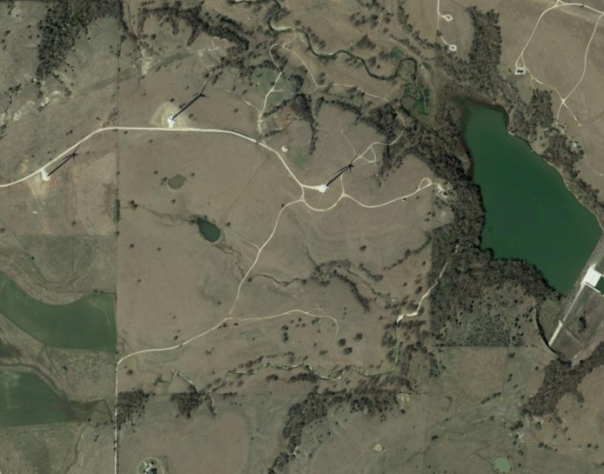
Invora™ Herbicide: Use Restrictions & Precautionary Information
Buffer Zone Restrictions for Property Lines
Property Lines
DO NOT apply broadcast within 100 ft of adjacent property lines.
Larger buffers may be necessary due to sensitive crops or prevailing wind.
Individual plant treatments may be made up to property line.
DO NOT spray or drift onto adjacent properties, sensitive crops or within root zone of sensitive species (note: tree roots on adjacent properties may extend well beyond the property line and into the soil of the treatment site)
Lake
Crop

Slide 26
Invora™ Herbicide: Use Restrictions & Precautionary Information
Buffer Zone Restrictions for Water Bodies
Free-flowing water bodies (creeks, streams, rivers, etc.):
DO NOT apply broadcast within 100 ft of water's edge.
Individual plant treatments may be made up to the water’s edge.
DO NOT apply directly to or allow to drift into water.
Lake
Crop

Slide 27
Invora™ Herbicide: Use Restrictions & Precautionary Information
Buffer Zone Restrictions for Water Bodies
Non-free-flowing water bodies (ponds, lakes, etc.) located wholly on the treatment site:
Aerial broadcast, ground broadcast, individual plant treatments are permissible up to the water’s edge.
DO NOT apply this product directly to or allow this product to drift into water.
Lake
Crop

Slide 28
Invora™ Herbicide: Use Restrictions & Precautionary Information
Buffer Zone Restrictions for Water Bodies
Non-free-flowing water bodies (ponds, lakes, etc.) NOT located wholly on the treatment site:
DO NOT apply broadcast within 100 ft of water's edge.
Individual plant treatments may be made up to water’s edge.
DO NOT apply this product directly to or allow this product to drift into water.
Lake
Crop

Slide 29
Invora™ Herbicide: Use Restrictions & Precautionary Information
Buffer Zone Restrictions – Water Bodies, Sensitive Crops, & Property Lines
Buffer Zones
Property lines
- 100 ft for broadcast
- 0 ft for IPT applications
Free-flowing water and water not wholly on site
- 100 ft for broadcast
- 0 ft for IPT applications
Lake
Non-free-flowing water wholly on treatment site
- 0 ft for broadcast
- 0 ft for IPT applications
Crop
Additional buffer to sensitive lands as necessary

Slide 30
Invora™ Herbicide: Use Restrictions & Precautionary Information
Buffer Zone Restrictions for Water Bodies
Irrigation ditches or canals:
DO NOT apply broadcast within 100 ft of the outer banks of irrigation ditches or canals.
Individual plant treatments may be made up to but NOT on the outer banks of dry or water-containing irrigation canals or ditches.
DO NOT apply through any type of irrigation system or contaminate water intended for irrigation.
DO NOT treat or allow spray drift or run-off to fall onto banks or bottoms of irrigation ditches, either dry or water containing, or other channels that carry irrigation water.
DO NOT apply this product directly to or allow this product to drift into water.

Slide 31
Invora™ Herbicide: Use Restrictions & Precautionary Information
Buffer Zone Restrictions for Water Bodies
Areas of temporary surface water:
This product may be applied to terrestrial sites that contain areas of temporary surface water, caused by collection of water in equipment ruts or in other depressions created by management activities.
It is permissible to treat intermittently flooded low lying sites, seasonally dry flood plains, and transitional areas between upland and lowland sites when no water is present.
It is also permissible to treat marshes, swamps, and bogs after water has receded, as well as seasonally dry flood deltas.

Slide 32
Picolinic Acid Chemistry Training
Topics:
✓ Introduction to Picolinic Acid Chemistry
✓Invora™ Herbicide
  Introduction
  Use Sites and Application Methods
  Use Restrictions and Precautionary Information
    Manure and Vegetation Management (Composting Awareness)
    Applications Around Desirable Species
    Buffer Zone Requirements
  The Application
Grazing Lands Stewardship
  Grazing management and wildlife considerations
Summary, Testing, & Certification

Slide 33
Invora™ Herbicide: The Application
Rate Structure and Application Methods
Broadcast applications through aerial or ground equipment
  12 to 48 fl oz/A + adjuvant* - single use rate based on target species
Spot and Individual Plant Treatment (IPT) Applications
  Spot application (targeting weeds) – 0.25 to 0.5% v/v solution + adjuvant*
  Foliar IPT (targeting brush) – 1.5% v/v solution + adjuvant*
  Cut stump – 6% to 10% v/v in water carrier + adjuvant* – spray after cutting
  Basal stem spray – 15% v/v in water carrier + adjuvant* – spray ground line to 14” height
Maximum use rates
  48 fl oz/A - maximum use rate in a single application
  54 fl oz/A – maximum use rate per year over combined applications
    Two applications are allowed per year with 14 days between applications
*A methylated seed oil + organo-silicone surfactant (MSO-OS) as a spray adjuvant is recommended unless otherwise specified on the label; see CROP SPECIES PRECAUTIONS section of the label.

Slide 34
Invora™ Herbicide: The Application
Mix a 1 gallon mix of a 15% v/v spray solution with 1% v/v adjuvant
Fluid ounces of Invora™ herbicide needed in 1 gallon of 15% v/v solution
  Know that 1 gallon = 128 fluid ounces
  Express 15% as a decimal; 15% ÷ 100 = 0.15
  Multiply total spray volume by this value; 128 x 0.15 = 19.2 fl. oz. Invora™ herbicide
Fluid ounces of MSO-OS* (1% v/v) needed in 1 gallon of solution
  Know that 1 gallon = 128 fluid ounces
  Express 1% as a decimal; 1% ÷ 100 = 0.01
  Multiply total spray volume by this value; 128 x 0.01 = 1.28 fl. oz. MSO-OS
Fluid ounces of water needed in 1 gallon of spray solution
  Know that 1 gallon = 128 fluid ounces
  Subtract herbicide and adjuvant volumes; 128 – 19.2 – 1.28 = 107.5 fl. oz. water
*A methylated seed oil + organo-silicone surfactant (MSO-OS) as a spray adjuvant is recommended unless otherwise specified on the label; see CROP SPECIES PRECAUTIONS section of the label.

Slide 35
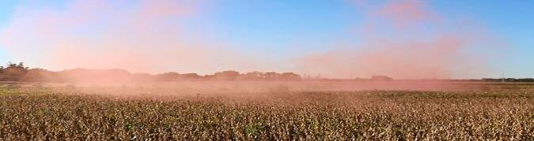
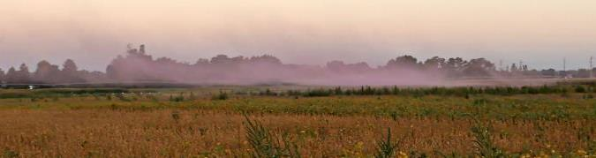
Invora™ Herbicide: The Application
Avoid Temperature Inversions – Use smoke as indicator
TEMPERATURE GRADIENT
AIR COOLS MOVING UPWARD
OPTIMAL CONDITIONS
Vertical Mixing of Air
2 - 10 mph winds
Avoid gusty conditions
Avoid windless conditions
TEMPERATURE INVERSION
CHARACTERISTICS
A LAYER OF COOL AIR TRAPPED
BELOW A LAYER OF WARMER AIR
Inversion Layer Near Surface
Poor vertical air mixing
Mist or fog present
Light to no wind - typical characteristic

Slide 36
Invora™ Herbicide: The Application
Avoid Off-target Physical Drift
Ensure the application stays on-target
  Wind – Drift potential is lowest when applications are made in light to gentle sustained winds (2-10 mph), which are blowing in a constant direction. Many factors, including droplet size and equipment type also determine drift potential at any given wind speed. AVOID GUSTY OR WINDLESS CONDITIONS.
  Local terrain can also influence wind patterns. Every applicator is expected to be familiar with local wind patterns and how they affect spray drift.

Slide 37
Invora™ Herbicide: The Application
Avoid Off-target Physical Drift
Ensure the application stays on-target
  Protect adjacent sensitive crops from drift: Do not apply this product when the wind is blowing toward adjacent crops including but not limited to; cotton, soybean, corn, wheat, tomatoes and other fruiting vegetables, fruit trees, cucurbits, grapes, beans, flowers, ornamentals, peas, potatoes, sunflower, plants in greenhouse(s), and broadleaf or grass hay crops.
  Special note: Invora™ Herbicide should NOT be allowed to drift onto adjacent grass crops (including but not limited to, grass-hay, wheat, corn, sorghum, etc.) due to:
    requirements to manage herbicide residues in vegetation for 2 years, and
    its potential impact to the growth and development of these crops.

Slide 38
Invora™ Herbicide: The Application
Avoid Off-target Physical Drift
Effect of droplet size over fall of 10 feet
10 FT*
DRIFTABLE FINES <141µm
10 MPH
WIND
1,000µm
400µm
200µm
100µm
10µm
1 SEC
15 FT
2 SEC
30 FT
4 SEC
60 FT
11 SEC
160 FT
TIME FOR DROPLET TO HIT GROUND
DRIFT DISTANCE
17 MIN
2.8 MI
Adapted from: Ross and Lembi, 1985. *Ten foot boom height for illustrative purposes only.

Slide 39
Invora™ Herbicide: The Application
Droplet size, carrier volume, adjuvants and tank-mix partners
  Droplet size specifications
    Use nozzles that deliver coarse to very coarse droplets (350 to 500 microns) as defined by ASABE S572 standard. Using smaller droplets than specified will not improve herbicide performance but will increase the risk of offsite movement through drift. Using larger droplets than specified will most likely result in reduced herbicide performance.
  Carrier volume
    4 to 10 GPA by aerial equipment and 10 to 20 GPA by ground equipment
  Drift retardants – allowed but volume mean diameter (VMD) droplet size must meet above specifications.
  Adjuvant - MSO-OS for most applications; See CROP SPECIES PRECAUTIONS section of label
  Tank-mix partners – Care should be taken if any tank mix partners are included (e.g. volatility of ester formulations)

Slide 40
Invora™ Herbicide: The Application
Observe appropriate application window for the target species
  Avoid brush applications if leaf canopy is over 25% damaged due to hail, insects, disease, or drought.
Honey Mesquite - late spring to midsummer when foliage is mature with a dark green color and when soil temperature reaches 75º F at a depth of 12 inches. Avoid applications when new mesquite growth is present due to recent rainfall.
Huisache - fall before November 1st.
Western Honey Mesquite - late summer to early fall, when there is adequate soil moisture. Avoid applications when new mesquite growth is present due to recent rainfall.

Slide 41
Invora™ Herbicide: The Application
Equipment / Sprayer Cleanup Requirement
Low rates of Invora™ herbicide can kill or severely injure most broadleaf crops and other desirable vegetation.
Applying pesticides or fertilizers to crops with the same equipment used to apply Invora™ herbicide may result in damage or loss.
The most effective way to reduce this crop damage potential is to use dedicated mixing and application equipment.
See the Invora™ herbicide label for specific clean-out procedures.

Slide 42
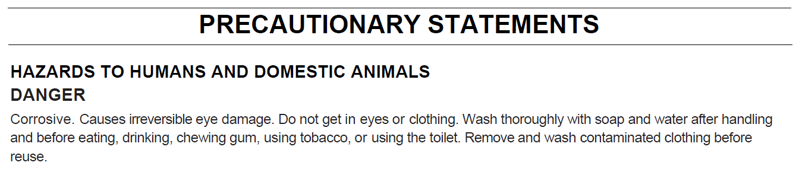
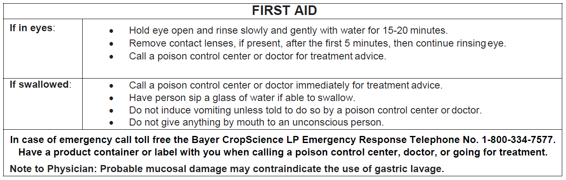
Invora™ Herbicide: The Application
Personal protective equipment (PPE)
Danger signal word – Eye Hazard

Slide 43
Invora™ Herbicide: The Application
Personal protective equipment (PPE)
  Applicators and other handlers must wear:
  Long-sleeved shirt and long pants
  Shoes plus socks
  Protective eyewear
  See the Invora™ herbicide label for additional information concerning:
    PPE required when using engineering controls
    PPE cleaning/maintenance requirements

Slide 44
Picolinic Acid Chemistry Training
Topics:
✓Introduction to Picolinic Acid Chemistry
✓Invora™ Herbicide
  Introduction
  Use Sites and Application Methods
  Use Restrictions and Precautionary Information
    Manure and Vegetation Management (Composting Awareness)
    Applications Around Desirable Species
    Buffer Zone Requirements
  The Application
Grazing Lands Stewardship
  Grazing management and wildlife considerations
Summary, Testing, & Certification

Slide 45
Grazing Lands Stewardship: Grazing Management
Proper grazing lands stewardship includes a proper grazing management plan:
  Brush and weeds are often indicators of bigger problems (e.g. over-stocking)
Grazing deferment after application may be needed to allow reestablishment of desired, herbaceous vegetation:
  Newly emerging plants need time to develop adequate root systems
Proper grazing management leaves desirable vegetative cover on the land to:
  Compete with germination and establishment of undesirable vegetation
  Reduce soil erosion from water and wind
  Support wildlife, etc.

Slide 46
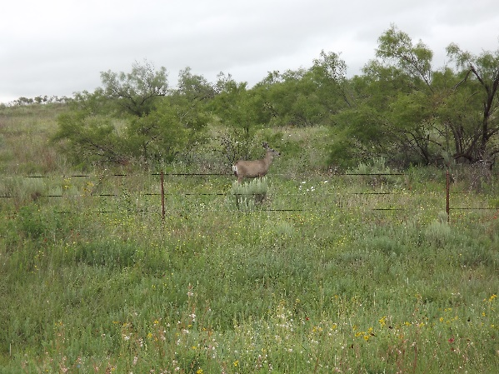
Grazing Lands Stewardship: Wildlife Considerations
Too much brush cover can obstruct production of wildlife beneficial vegetation
Some brush cover is necessary to promote healthy wildlife habitat
Amount and distribution of brush cover should be determined based on wildlife species present and/or desired
  Consult a wildlife biologist

Slide 47
Summary: Invora™ Herbicide Label Requirements
For use on privately-owned, non-hayed, rangeland and perennial grasslands managed as rangelands in the states of Arizona, New Mexico, Oklahoma, and Texas
Applicator Requirements
DO NOT apply this product:
to sites where vegetation will be harvested or manure will be collected within 2 years
broadcast within 100 ft. of property lines, free-flowing water bodies, water bodies shared among property owners, or outer banks of irrigation ditches or canals
directly to or allow to drift into water
in the root zone of or directly to desirable vegetation
if conditions favor movement off site
Read and follow all product label directions, restrictions, & precautions.

Slide 48
Invora™ Herbicide: Label Requirements
For use on privately-owned, non-hayed, rangeland and perennial grasslands managed as rangelands in the states of Arizona, New Mexico, Oklahoma, and Texas
Land Manager Requirements
For 2 years after treatment:
herbaceous vegetation cannot be harvested, moved off-site, composted, or used as soil amendment or mulch
manure resulting on treatment site cannot be composted, used as soil amendment or mushroom spawn
purge livestock for 3 days before transport
Treated brush must degrade on site
Read and follow all product label directions, restrictions, & precautions.

Slide 49
Thank you for your attention. Any questions?
Disclaimer: ALWAYS READ AND FOLLOW LABEL INSTRUCTIONS. This presentation is intended solely to satisfy the applicator training requirement contained on the Invora herbicide label and is not intended as a replacement for reading and following all label directions, restrictions, and precautions for Invora herbicide and/or any other picolinic acid product. Please contact your State Lead Agency or a manufacturer’s representative for the specific picolinic acid containing product being applied should any questions or issues arise. The information contained in this presentation is based on information available at the time of drafting and is subject to update at any time. Not all products are registered in all states. Bayer, the Bayer Cross and Invora are trademarks of Bayer Group. Chaparral, Grazon, GrazonNext, MezaVue, Reclaim, Remedy, Sendero, Surmount, and Tordon are trademarks of Dow AgroSciences LLC.

Slide 50
Test Questions

Slide 51
Question 1
Invora™ herbicide is labeled for use in which of the following states?
(select all that apply)
Alabama
Alaska
Arizona
Arkansas
Nebraska
Nevada
New Hampshire
New Jersey
New Mexico
New York
North Carolina
North Dakota
Ohio
Oklahoma
Oregon
Tennessee
Texas

Slide 52
Question 1
Invora™ herbicide is labeled for use in which of the following states?
(select all that apply)
Alabama
Alaska
Arizona
Arkansas
Nebraska
Nevada
New Hampshire
New Jersey
New Mexico
New York
North Carolina
North Dakota
Ohio
Oklahoma
Oregon
Tennessee
Texas

Slide 53
Question 2
Invora™ herbicide is labeled for which of the following privately-owned use sites?
(select all that apply)
Non-hayed rangeland
Non-hayed perennial grassland managed for seed production
Non-hayed perennial grassland managed as rangeland
Grass hay production fields
All the above

Slide 54
Question 2
Invora™ herbicide is labeled for which of the following privately-owned use sites?
(select all that apply)
Non-hayed rangeland
Non-hayed perennial grassland managed for seed production
Non-hayed perennial grassland managed as rangeland
Grass hay production fields
All the above
a. & c. Invora herbicide is only labeled for use on privately-owned, non-hayed, rangeland and privately-owned, non-hayed perennial grasslands managed as rangeland.
b. & d. Invora herbicide is not labeled for seed or hay production sites.

Slide 55
Question 3
Broadcast applications of Invora™ herbicide require a 100 ft buffer to which of the following?
River
Large lake not wholly located on the treatment site
Outer bank of irrigation canal
Property line
All the above

Slide 56
Question 3
Broadcast applications of Invora™ herbicide require a 100 ft buffer to which of the following?
River
Large lake not wholly located on the treatment site
Outer bank of irrigation canal
Property line
All the above
e. Broadcast applications of Invora herbicide require a 100 ft. buffer to free-flowing water bodies, water bodies not wholly located on the treatment site, outer banks of irrigation canals and ditches, and property lines.

Slide 57
Question 4
Rangeland with Honey Mesquite
Bermudagrass Hay Field
The owner of a section of land (640 acres) wishes to spray Invora™ herbicide for honey mesquite on rangeland. He maintains the NE 80 acres as a bermudagrass hay field.
At the time of application, the wind is blowing toward the NE at 10 mph. Although (1) the bermudagrass hay field is owned and managed by the land owner and (2) bermudagrass is tolerant to the treatment, an untreated buffer should be left around the hay production field.
True
False
Wind Direction
10 mph

Slide 58
Question 4
Rangeland with Honey Mesquite
Bermudagrass Hay Field
The owner of a section of land (640 acres) wishes to spray Invora™ herbicide for honey mesquite on rangeland. He maintains the NE 80 acres as a bermudagrass hay field.
At the time of application, the wind is blowing toward the NE at 10 mph. Although (1) the bermudagrass hay field is owned and managed by the land owner and (2) bermudagrass is tolerant to the treatment, an untreated buffer should be left around the hay production field.
True
False
Wind Direction
10 mph
First, one must observe the requirement of, “treated herbaceous vegetation cannot be mechanically harvested or moved for 2 years following treatment.” Second, Invora is not labeled for hay production fields, even drift rates would be off-label. For these reasons, the applicator should not spray or drift on the bermudagrass field.

Slide 59
Question 5
Invora™ herbicide is a member of the picolinic acid herbicide family. Characteristics of most products in this family, including Invora™ herbicide, are:
(select all that apply)
Active on broadleaf vegetation
Soil residual activity
Potential to drift
Compost contamination concerns from treated vegetation or resulting manure
All the above

Slide 60
Question 5
Invora™ herbicide is a member of the picolinic acid herbicide family. Characteristics of most products in this family, including Invora™ herbicide, are:
(select all that apply)
Active on broadleaf vegetation
Soil residual activity
Potential to drift
Compost contamination concerns from treated vegetation or resulting manure
All the above
e. Invora™ herbicide and most other picolinic acid herbicides are active on broadleaf vegetation, have soil residual activity, can drift, and their residual properties in vegetation raise concerns around compost.

Slide 61
Question 6
Invora™ herbicide is a Restricted Use Pesticide and requires applicator certification to apply?
True
False

Slide 62
Question 6
Invora™ herbicide is a Restricted Use Pesticide and requires applicator certification to apply?
True
False
Invora™ herbicide is a Restricted Use Pesticide due to its potential to injure susceptible, non-target plants and it is for retail sale only to and use only by certified applicators or persons under their direct supervision and only those uses covered by the certified applicator’s certification. In addition, every two years all applicators must complete picolinic acid chemistry training prior to applying Invora™ Herbicide.

Slide 63
Question 7
Following an application of Invora™ herbicide herbaceous vegetation cannot be mechanically harvested for a period of
12 months
18 months
20 months
24 months
There is no time restriction

Slide 64
Question 7
Following an application of Invora™ herbicide herbaceous vegetation cannot be mechanically harvested for a period of
12 months
18 months
20 months
24 months
There is no time restriction

Slide 65
Question 8
Following an application of Invora™ herbicide treated brush can be removed from the treatment site after how many months?
12 months
18 months
20 months
24 months
Never, treated brush must degrade on the treatment site

Slide 66
Question 8
Following an application of Invora™ herbicide treated brush can be removed from the treatment site after how many months?
12 months
18 months
20 months
24 months
Never, treated brush must degrade on the treatment site

Slide 67
Question 9
Livestock grazing an Invora™ treated site can be moved to winter wheat pasture under which of the conditions:
(select all that apply)
After 18 months of the application
Within 24 months of application
Within 24 months of the application if livestock are fed for 3 days a diet free of picolinic acid treated vegetation
After 24 months
Never

Slide 68
Question 9
Livestock grazing an Invora™ treated site can be moved to winter wheat pasture under which of the conditions:
(select all that apply)
After 18 months of the application
Within 24 months of application
Within 24 months of the application if livestock are fed for 3 days a diet free of picolinic acid treated vegetation
After 24 months
Never
Within 24 months after an Invora™ herbicide application livestock must be fed forage not previously treated with Invora™ herbicide or other similar chemistries for at least 3 days before transport off the property or being moved to sites other than no-hayed rangeland or non-hayed perennial grassland managed at rangeland. After 24 months have elapsed from the time of application livestock can be freely moved.

Slide 69
Question 10
Required personal protective equipment for handlers and applicators of Invora™ herbicide include:
  long-sleeved shirt
  long pants
  shoes plus socks
  protective eyewear
  all the above

Slide 70
Question 10
Required personal protective equipment for handlers and applicators of Invora™ herbicide include:
  long-sleeved shirt
  long pants
  shoes plus socks
  protective eyewear
  all the above

Slide 71
Question 11
Invora™ herbicide is NOT labeled for use on government owned and operated lands such as Bureau of Land Management (BLM) lands and Texas Parks and Wildlife lands.
  True
  False

Slide 72
Question 11
Invora™ herbicide is NOT labeled for use on government owned and operated lands such as Bureau of Land Management (BLM) lands and Texas Parks and Wildlife lands.
  True
  False
BLM and Texas Parks and Wildlife lands are considered public lands. Invora™ herbicide is not labeled for use on public lands.

Slide 73
Question 12
Invora™ herbicide can negatively impact desirable vegetation through:
  Foliar uptake through leaves of treated plants
  Root uptake from spray contacting the ground under desirable plants
  Drift rates blowing onto adjacent fields, crops, or trees
  Application to water bodies used for irrigation
  All the above

Slide 74
Question 12
Invora™ herbicide can negatively impact desirable vegetation through:
  Foliar uptake through leaves of treated plants
  Root uptake from spray contacting the ground under desirable plants
  Drift rates blowing onto adjacent fields, crops, or trees
  Application to water bodies used for irrigation
  All the above

Slide 75
Question 13
Invora™ herbicide can be applied to which following sites:
  Hay production fields
  Public lands
  Lands where animals are confined AND manure is collected
  Winter wheat field
  Privately-owned, non-hayed rangeland and privately-owned, non-hayed perennial grasslands managed as rangeland.

Slide 76
Question 13
Invora™ herbicide can be applied to which following sites:
  Hay production fields
  Public lands
  Lands where animals are confined AND manure is collected
  Winter wheat field
  Privately-owned, non-hayed rangeland and privately-owned, non-hayed perennial grasslands managed as rangeland.
e. Invora™ herbicide is only labeled for use on privately-owned, non-hayed, rangeland and privately-owned, non-hayed perennial grasslands managed as rangeland.
a., b., c., & d. Invora™ herbicide is not labeled for any of these use sites.

Slide 77
Question 14
How often is picolinic acid chemistry certification required to apply Invora™ herbicide?
  Every year
  Every 2 years
  Every 3 years
  Every 18 months

Slide 78
Question 14
How often is picolinic acid chemistry certification required to apply Invora™ herbicide?
  Every year
  Every 2 years
  Every 3 years
  Every 18 months
b. Prior to applying Invora™ herbicide, all applicators must complete picolinic acid chemistry training every two years.

Slide 79
Question 15
Individual plant treatment (IPT) applications of Invora™ herbicide are labeled for the following applications?
(select all that apply)
  Up to the property line
  Up to the water’s edge of free-flowing water bodies
  To privately-owned, non-hayed rangeland and perennial grasslands managed as rangeland
  On hay production fields
  Where animals are confined AND manure is collected

Slide 80
Question 15
Individual plant treatment (IPT) applications of Invora™ herbicide are labeled for the following applications?
(select all that apply)
  Up to the property line
  Up to the water’s edge of free-flowing water bodies
  To privately-owned, non-hayed rangeland and perennial grasslands managed as rangeland
  On hay production fields
  Where animals are confined AND manure is collected
a., b., & c. IPT applications of Invora™ herbicide are labeled for use up to property lines and the edge of free-flowing water bodies on privately-owned, non-hayed, rangeland and privately-owned, non-hayed perennial grasslands managed as rangeland.
d. & e. Invora™ is not labeled for hay fields or sites where animals are confined AND manure is collected.

Slide 81
Question 16
Invora™ herbicide application requirements for broadcast sprays include “using nozzles that deliver coarse to very coarse droplets (350 to 500 microns) as defined by ASABE S572 standard.” Using smaller droplet sizes will increase risk of offsite movement through drift.
  True
  False

Slide 82
Question 16
Invora™ herbicide application requirements for broadcast sprays include “using nozzles that deliver coarse to very coarse droplets (350 to 500 microns) as defined by ASABE S572 standard.” Using smaller droplet sizes will increase risk of offsite movement through drift.
  True
  False
Reducing droplet size to those smaller than coarse to very coarse does not improve brush efficacy but does significantly increase the risk of off-site movement through drift.

Slide 83
Question 17
Broadcast applications of Invora™ herbicide can be made up to the water’s edge for which of the following?
(select all that apply)
  Free-flowing creek
  Dry irrigation ditch
  Pond located wholly on the treatment site
  Lake whose frontage is shared by multiple land owners
  All the above

Slide 84
Question 17
Broadcast applications of Invora™ herbicide can be made up to the water’s edge for which of the following?
(select all that apply)
  Free-flowing creek
  Dry irrigation ditch
  Pond located wholly on the treatment site
  Lake whose frontage is shared by multiple land owners
  All the above
c. Broadcast applications of Invora™ herbicide can be made up to water’s edge of non-free flowing water bodies wholly located on the treatment site.
a., b., & d. A minimum 100 ft. buffer to water’s edge must be observed with broadcast Invora™ applications around free-flowing water bodies and water bodies not wholly on the treatment site. A 100 ft. buffer to outer banks of irrigation canals or ditches must also be observed with broadcast Invora™ applications.

Slide 85
Question 18
It is not permissible to spray or drift Invora™ herbicide into a non-free-flowing pond even when the pond is wholly located on the treated site?
  True
  False

Slide 86
Question 18
It is not permissible to spray or drift Invora™ herbicide into a non-free-flowing pond even when the pond is wholly located on the treated site?
  True
  False
It is not permissible to spray or allow Invora™ Herbicide to drift into water bodies.

Slide 87
Question 19
The labeled carrier volume for aerial applications of Invora™ herbicide is
  1 to 2 gallon per acre
  2 to 4 gallons per acre
  3 to 4 gallons per acre
  4 to 10 gallons per acre
  There are no specifications on the label for aerial applications

Slide 88
Question 19
The labeled carrier volume for aerial applications of Invora™ herbicide is
  1 to 2 gallon per acre
  2 to 4 gallons per acre
  3 to 4 gallons per acre
  4 to 10 gallons per acre
  There are no specifications on the label for aerial applications
d. At least 4 gallons per acre of carrier volume should be used to apply Invora™ Herbicide through aerial broadcast applications.
a., b., & c. Lower carrier volumes typically result in reduced spray coverage and reduced control.

Slide 89
Question 20
Basal stem sprays and cut stump sprays of Invora™ herbicide must be made with which of the following carrier(s)?
  water
  diesel
  kerosene
  basal oil
  Any of the above

Slide 90
Question 20
Basal stem sprays and cut stump sprays of Invora™ herbicide must be made with which of the following carrier(s)?
  water
  diesel
  kerosene
  basal oil
  Any of the above
d. Water is the only carrier labeled for basal stem and cut stump sprays of Invora™ Herbicide.
b., c., & d. These carriers are not labeled for use with Invora™ Herbicide.

Slide 91
Question 21
The land owner must be notified if Invora™ herbicide is applied to privately-owned, non-hayed rangeland managed under a lease agreement?
  True
  False

Slide 92
Question 21
The land owner must be notified if Invora™ herbicide is applied to privately-owned, non-hayed rangeland managed under a lease agreement?
  True
  False
In addition, there must be at least 24 months of contract-life remaining on the lease at the time of the application.

Slide 93
Question 22
To make Invora™ herbicide applications to privately-owned, non-hayed, rangeland managed under a lease agreement the lease agreement must have at least ____months of lease-life remaining.
  12
  18
  24
  36
  48

Slide 94
Question 22
To make Invora™ herbicide applications to privately-owned, non-hayed, rangeland managed under a lease agreement the lease agreement must have at least ____months of lease-life remaining.
  12
  18
  24
  36
  48
In addition, the land owner must be notified of the application.

Slide 95
Question 23
Invora™ herbicide is a restricted use pesticide due to:
  its potential to drift
  its potential to injure or kill susceptible, non-target plants
  the eye hazard of the product
  all the above

Slide 96
Question 23
Invora™ herbicide is a restricted use pesticide due to:
  its potential to drift
  its potential to injure or kill susceptible, non-target plants
  the eye hazard of the product
  all the above
b. This information is found in the “Restricted Use Pesticide” box at the top of the label.

Slide 97
Question 24
After spraying Invora™ herbicide it is necessary to thoroughly clean the spray equipment before spraying which of the following:
  cotton
  wheat
  soybean
  bermudagrass hay field
  all the above

Slide 98
Question 24
After spraying Invora™ herbicide it is necessary to thoroughly clean the spray equipment before spraying which of the following:
  cotton
  wheat
  soybean
  bermudagrass hay field
  all the above
e. Spray equipment should be thoroughly cleaned prior to using the equipment to treat any crop other than non-hayed rangeland or perennial grasslands managed as rangeland.

Slide 99
Question 25
The maximum single use rate per acre for Invora™ herbicide is:
  12 fl. oz.
  24 fl. oz.
  36 fl. oz.
  48 fl. oz.

Slide 100
Question 25
The maximum single use rate per acre for Invora™ herbicide is:
  12 fl. oz.
  24 fl. oz.
  36 fl. oz.
  48 fl. oz.
e. The maximum use rate for Invora™ Herbicide in any single application is 48 fl. oz./acre.

